Slide 1

Colombo Xamarin Meetup
Session : Resources and Styles
By : Buddhima Kudagama

Slide 2

Using Attributes in Entire App creates => consistent look and feel
XF provides a way =>
Define values in one place
Look them up in anywhere
Does =>
Consistency across app
Make update simple

Slide 3
Xamarin Forms allows…
Apply resources in C# code and XAML
Group multiple settings into a Style
Advantages..
Avoid -> Duplicate XAML with resources
Create -> consistent UI with style
Resources and styles available across entire app
User accessibility choice with built-in styles

Slide 4
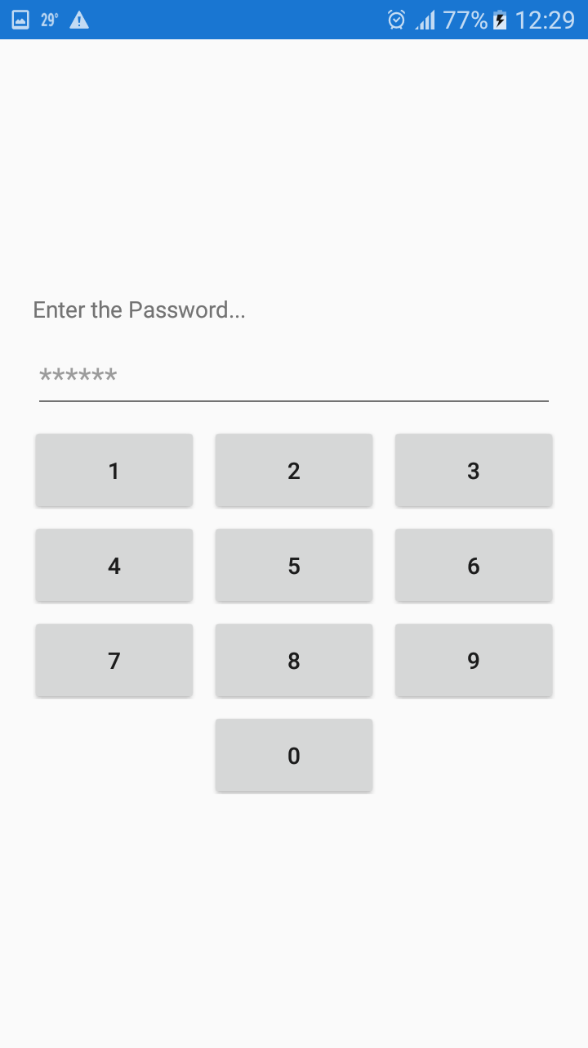
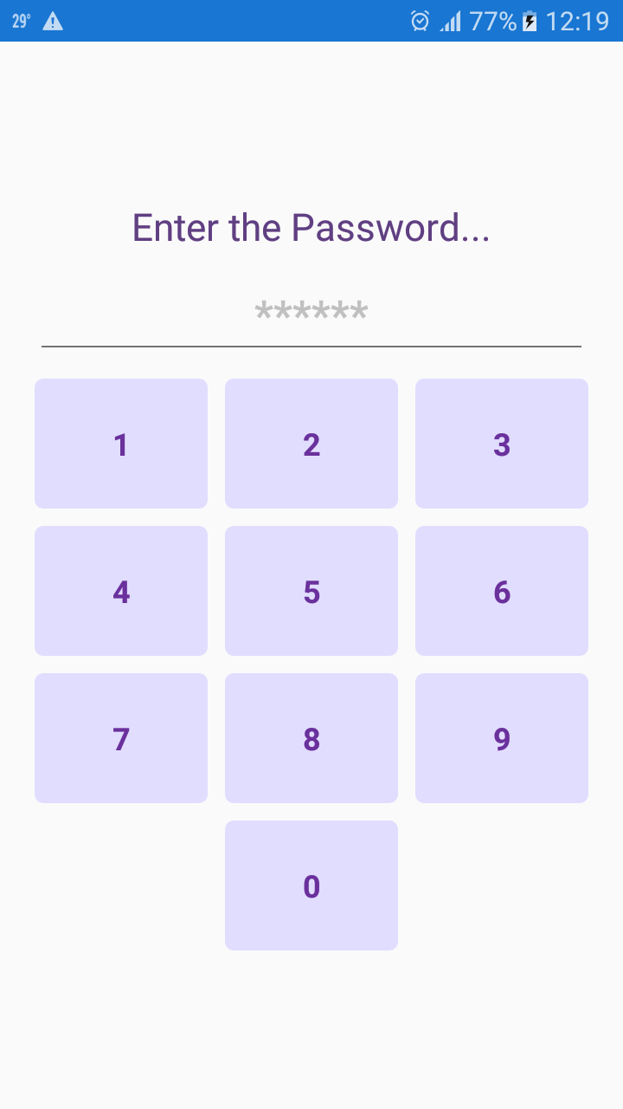
Adding Inline styles

Slide 5
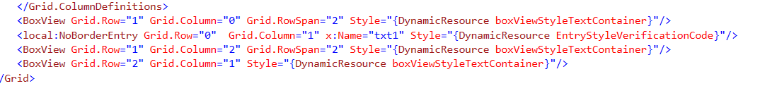
Symbolic constants
Substitute for a sequence of character that cannot be changed.
Advantages..
Descriptive Name
ex: “HeaderTextStyle”,”PasswordStyle”
Value is defined in one place

Slide 6
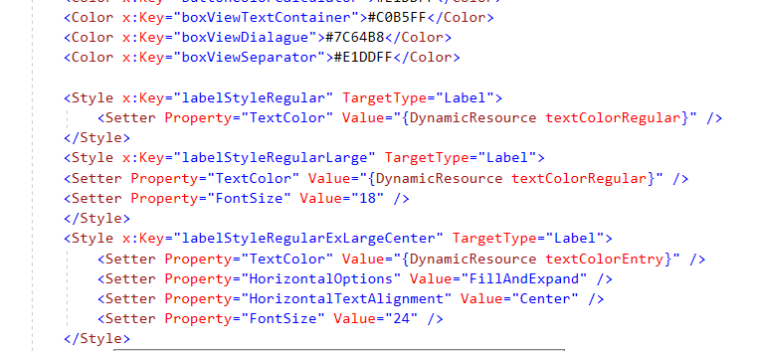
XAML allows - Store styles in a shared dictionary (Key-Value pair) and look them up everywhere.
Every page can have resource dictionary.
Can create by C# code or XAML

Slide 7

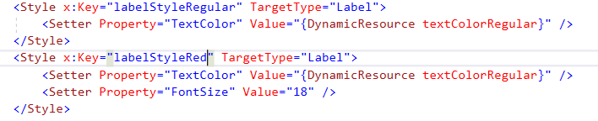

Page’s Resource property is null by default.
So we have to create an object of Resource Dictionary
Resources are most often create by XAML
Resource names …
should be based on use,
Not value

Slide 8
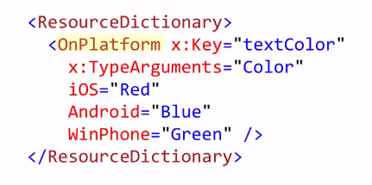
Resource dictionary allow to store any object even OnPlatform object.
Static Resource | Dynamic Resource
does not update values when update the value in the dictionary key is not in dictionary -> runtime exception thrown | Update values No exception throws

Slide 9
Dynamic Resources
Change the look of the UI at runtime
Update resources after the application has started -> no exception
Dynamic Resources does …
Load resource values when the target is created
Listen to the dictionary value changes and updates the UI properties
It leaves the property un-set.
DR has created to handle resources when the resources is not available at the start up.

Slide 10
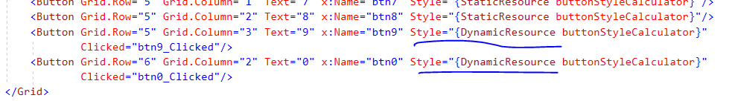

Resource can be set using code behind using…
SetDynamicResource()
Resource can be modify in code behind using…

Slide 11
Create consistent UI
with styles
Style…
A group of property settings for a particular type
Setter…
Is a container for a property -> key value pair
Can apply same style to many components

Slide 12
Styles has 2 main Advantages
Result XAML is cleaner -> one property setting instead of several lines/individual settings
Encourages consistency

Slide 13
Implicit Styles
Style with-out a x:key property has a special meaning…
Becomes an implicit style - apply to all objects of the target type
Implicit styles => type should match exactly

Slide 14
Explicit Styles
Explicit style =>Target Type should not match exactly
Can apply to all types of controls

Slide 15

Inherit Styles
Inherit styles from an existing style
BasedOn=“{…}”
Only Static Resources is allow to inherit base styles…
BasedOn=“{StaticResource SomeStyle}”
BasedOn=“{DynamicResource SomeStyle}”

Slide 16

Blog : xamarinsharp.com
YouTube : Xamarinsharp
Linkedin : Buddhima Kudagama
Email : kgbuddhima@gmail.com
Thank You !

